Slide 1
Product, Open Source, Community
Adrin Jalali
:Probabl.

Slide 2
Product / Project
What are you building?

Slide 3
An open source client to your backend
Users ↔ Platform
Contributors: You
Users: overlap with customers
Governance: closed
Release / update pace: fast

Slide 4
A Product / Library, Happens to be OSS
It’s your product, but you offer a free version
  You want the attention coming with having it as OSS
Contributors: You
  Others will be opening issues, and sometimes feature/fix PRs
Users: overlap with customers
Governance: closed
  How do you handle external contributions/feature requests?
Release / update pace: fast

Slide 5
An Open Governance OSS Product / Library
It’s a product / library you want to champion
  You want people to know you because of it
Contributors: You & Others
  You want to empower others and let them lead projects
  You want to be a/the center of gravity, or not
Users: overlap with customers
Governance: open
  How do you handle external contributions/feature requests?
Release / update pace: depends, slow

Slide 6
Community

Slide 7
7 Deadly Sins!
Or what you really should not do!
https://chaoss.github.io/website/CHAOSScon/2020EU/slides/seven_deadly_sins.pdf

Slide 8
1. Lack of Onboarding
What is the project? Why is it useful?
How is it used?
How do users get it?

Slide 9
1. Lack of Onboarding
High barrier to entry
Harder to create a community
Reduced diversity (which is already a huge issue)

Slide 10
1. Lack of Onboarding
README
CONTRIBUTING
Code Quality: pre-commit hooks?
CI / tests
  Can everybody run them?

Slide 11
Internal vs External
Workflow requires people to be in the team?
PRs/MRs from forks vs branches on the main repo
Group members merging their own PRs
Treat people equally, as much as it’s feasible!

Slide 12
2. Nothing in Writing
Documentation Driven API Design
The kind that runs!

Slide 13
2. Nothing in Writing
Usage docs
API docs
Versioned docs
  When were features added?
Code documentation
  Private as well as public
  Maintainers need docs too!
Sphinx + sphinx-gallery + readthedocs

Slide 14
3. Leadership is a Mystery
Who’s making decisions?
Whom should I ask?
Whose review should I care about? Everybody?
Anybody I could talk to?

Slide 15
4. No Path to Success
What is success?
  Being asked to give an opinion?
  Becoming a core developer?
  Being in committee X, Y, Z?
  Advisory board?
Engagement
  Some people might just want to code
  It’s okay if they want more

Slide 16
5. Poor Communication
Communication matters
  Especially for people who care
50% of text and email messages are misunderstood
People with a history vs strangers
Reviews are criticisms [almost] by nature, it’s easy to offend people!

Slide 17
5. Poor Communication
Use emojis
Understand other people’s emotions!
Monitor your mailing list / issue tracker / chat channels for heated discussions
  Have or be mediators

Slide 18
6. Lack of Transparency
Office communication
Communication behind closed doors
  Company Slack?
Important communication spread across different channels
  Decisions made on a chat convo, and done in a PR w/o a summary
Private communication between members

Slide 19
6. Lack of Transparency
“Outsiders” would feel their opinion doesn’t matter
  Do their opinions matter to you?
Barrier to get into the inner circle

Slide 20
7. Not Seeing Ourselves in Others
Empathy!
  Understand others’ emotions and needs
Emotional intelligence
Be a feedback magnet!

Slide 21
Lack of onboarding
Nothing in writing
Leadership is a mystery
No path to success
Poor communication
Lack of transparency
Not seeing ourselves in others

Slide 22
Governance
https://www.redhat.com/en/resources/guide-to-open-source-project-governance-models-overview

Slide 23
Do-ocracy
No formal process
Decisions are made by those who do the work
Contributors get effective rights on things they work the most
Pros
No overhead
Cons
Implicit governance
Not clear to outsiders what the governance is

Slide 24
Founder-leader (BDFL)
Most common in new projects
The founder takes the Benevolent Dictator For Life role
  E.g.: was Guido for Python
Pros
Easy to start with
Low overhead
Cons
This raises issues once the project starts to grow
BDFL’s preferences and project’s direction

Slide 25
Self Appointing Council or Board
Pros
No single point of failure
No single person with their preferences
Cons
Self selection and lack of user base representation
Lack of progress clarity and ownership from community members

Slide 26
Electoral
Multiple people offer to do the same role
Large project / contributor base
Pros
Projects with sponsors
Explicit term limits
Cons
Time consuming
Slow
Who votes?

Slide 27
Single Vendor
Pros
Engage with a broader community
Increase adoption
E.g.: a plugin ecosystem
Cons
Might be a walled garden kind of project
Dual license and contributions
Open or not?

Slide 28
Foundation Backed
Pros
Trademark, merch, etc handled by a trusted org
  E.g.: NumFocus for many NumFocus sponsored projects
Flexibility on foundation leadership vs project leadership
Funding opportunities
Cons
Overhead
Potentially very slow processes

Slide 29
Which one to Choose ???

Slide 30
The License World!

Slide 31
Terms / Orgs
Open Source
FOSS: Free and Open Source Software
OSI: Open Source Initiative
FSF: Free Software Foundation
Debian
Fedora

Slide 32
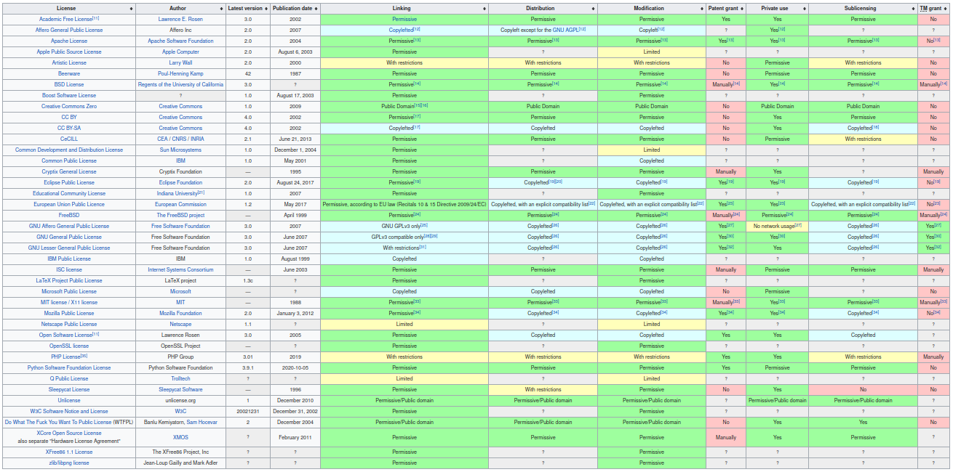
https://en.wikipedia.org/wiki/Comparison_of_free_and_open-source_software_licenses

Slide 33
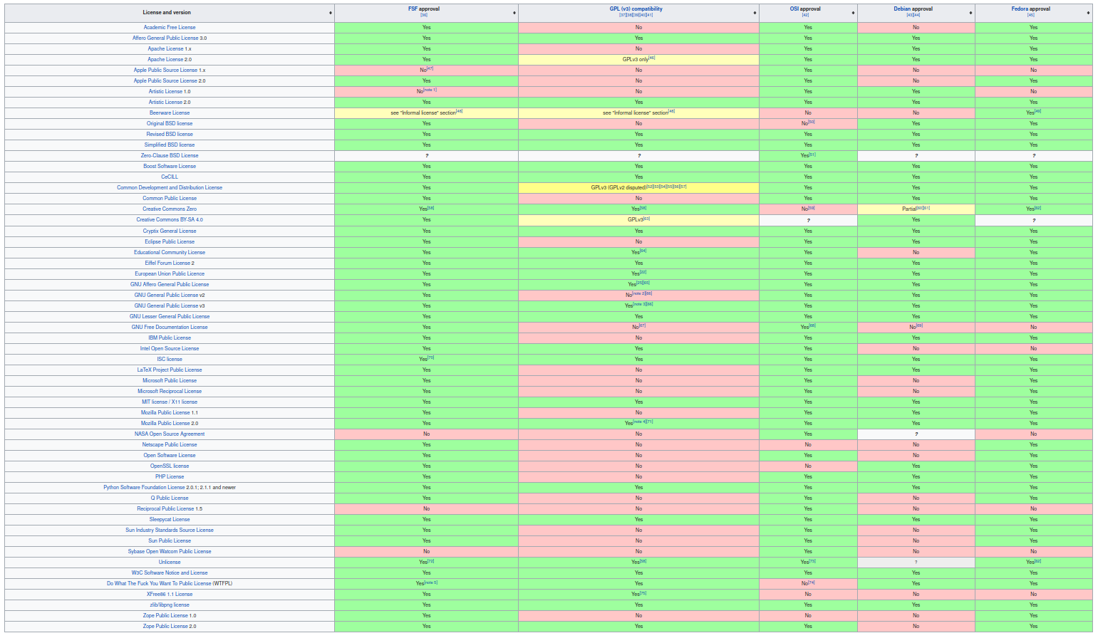
https://en.wikipedia.org/wiki/Comparison_of_free_and_open-source_software_licenses

Slide 34
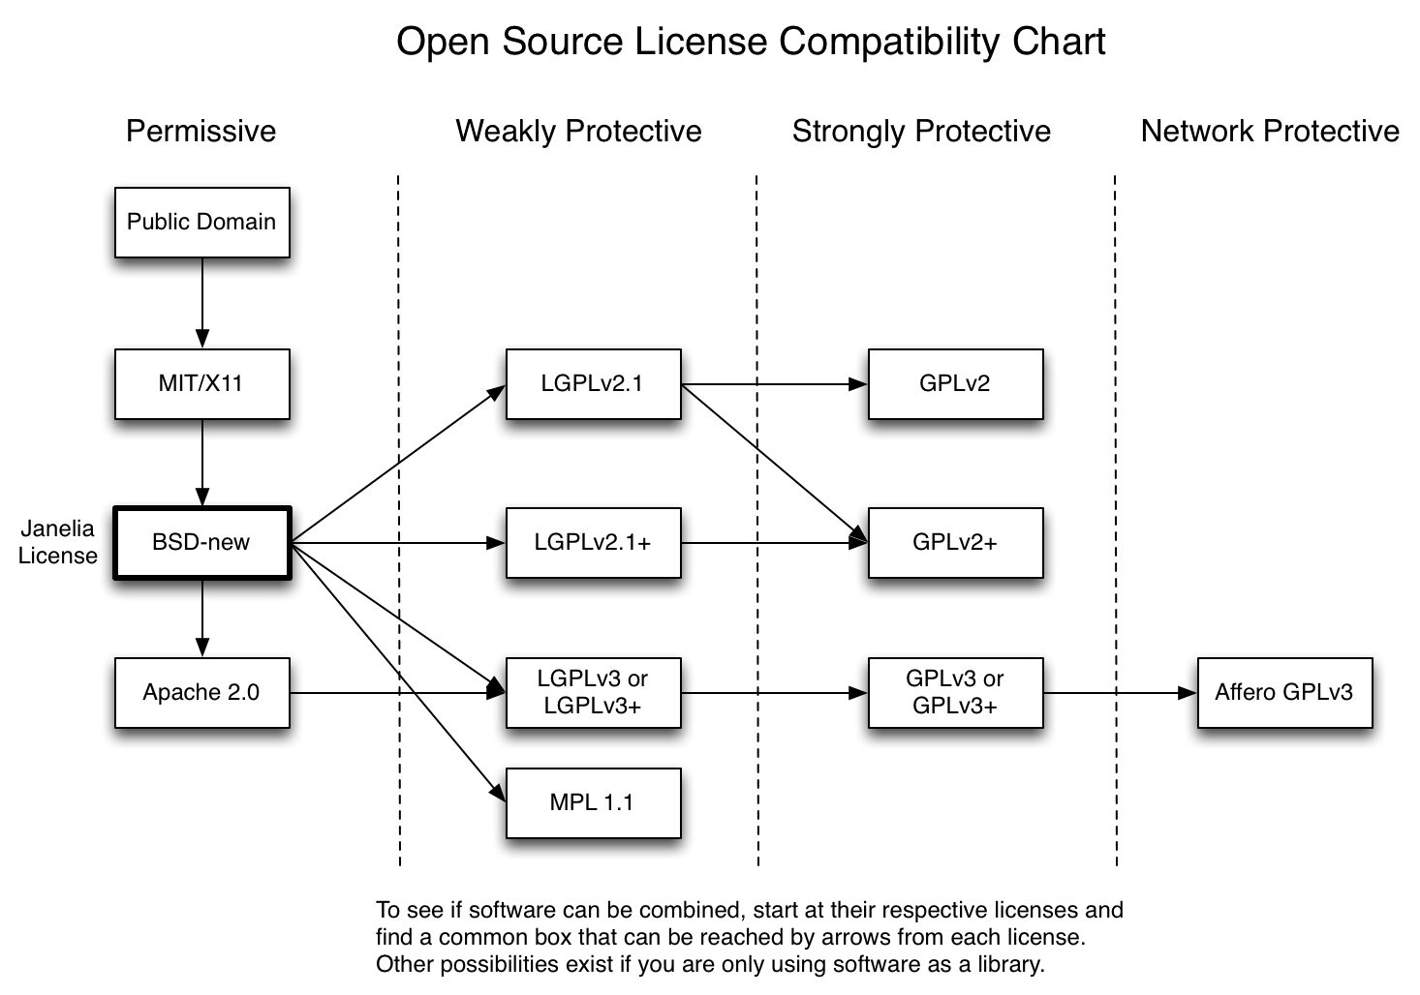
http://janelia-flyem.github.io/licenses.html

Slide 35
Open Source’s Midlife Crisis
Company X open sources a product under a license
Some large cloud company uses it as a service
Company X changes license

Slide 36
Server Side Public License
“SSPL requires that anyone who offers the functionality of SSPL-licensed software to third-parties as a service must release the entirety of their source code, including all software, APIs, and other software that would be required for a user to run an instance of the service themselves.”
=> if you’re AWS and you host ElasticSearch under SSPL, you need to release a LOT of code.
=> incompatible with a lot of other licenses, including Linux kernel
=> Not OSI approved

Slide 37
Resources

Slide 38





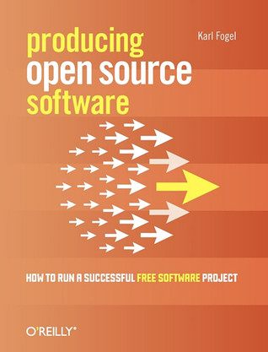

Slide 39
Resources
OSI’s Open Source Management Course and Resources
RedHat’s articles on Open Source Communities
Linux Foundation’s Inclusive Open Source Community Orientation
Center for Scientific Collaboration and Community Engagement
…

Slide 40
♡ Thank YOU ♡
Questions ?!

